Slide 1

Boston Housing Data(Python Linear Regression Model)
A Project by Debasmita Paul

Slide 2
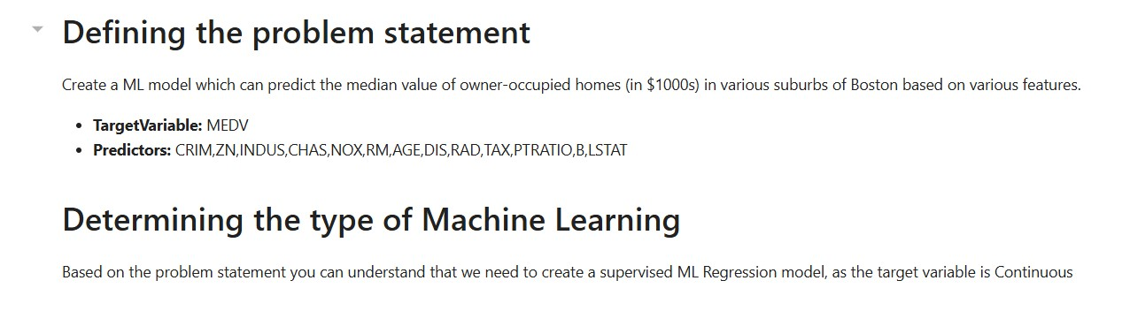
Defining The Problem And Determining The ML Approach
The objective is to develop a supervised machine learning regression model that predicts the median value of owner-occupied homes (MEDV) in Boston suburbs based on various features. This model will utilize predictors such as crime rate, number of rooms, and distance to employment centers to provide accurate housing value estimates.

Slide 3
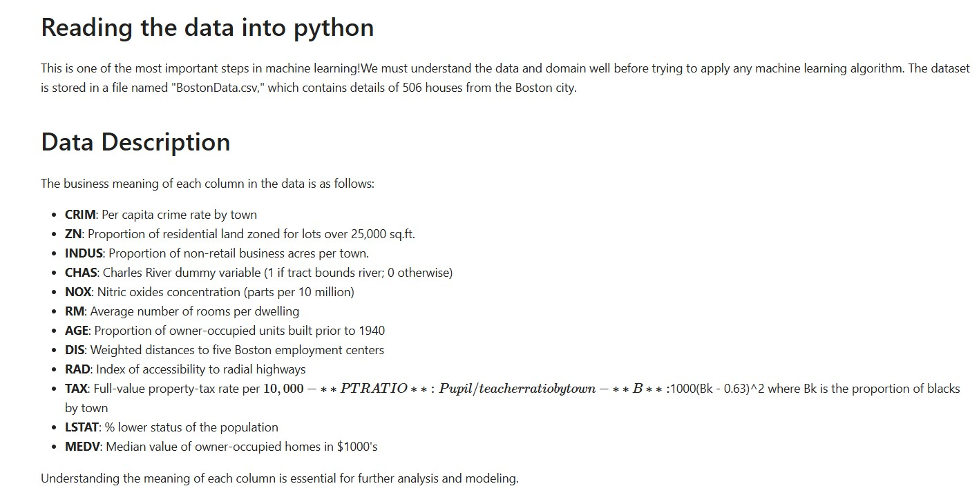
Data Overview And Understanding
The dataset 'BostonData.csv' contains details of 506 houses in Boston, with columns representing various features like crime rate, number of rooms, and property tax rates, crucial for understanding housing values. Familiarity with each column's business meaning is essential for effective analysis and modeling.

Slide 4
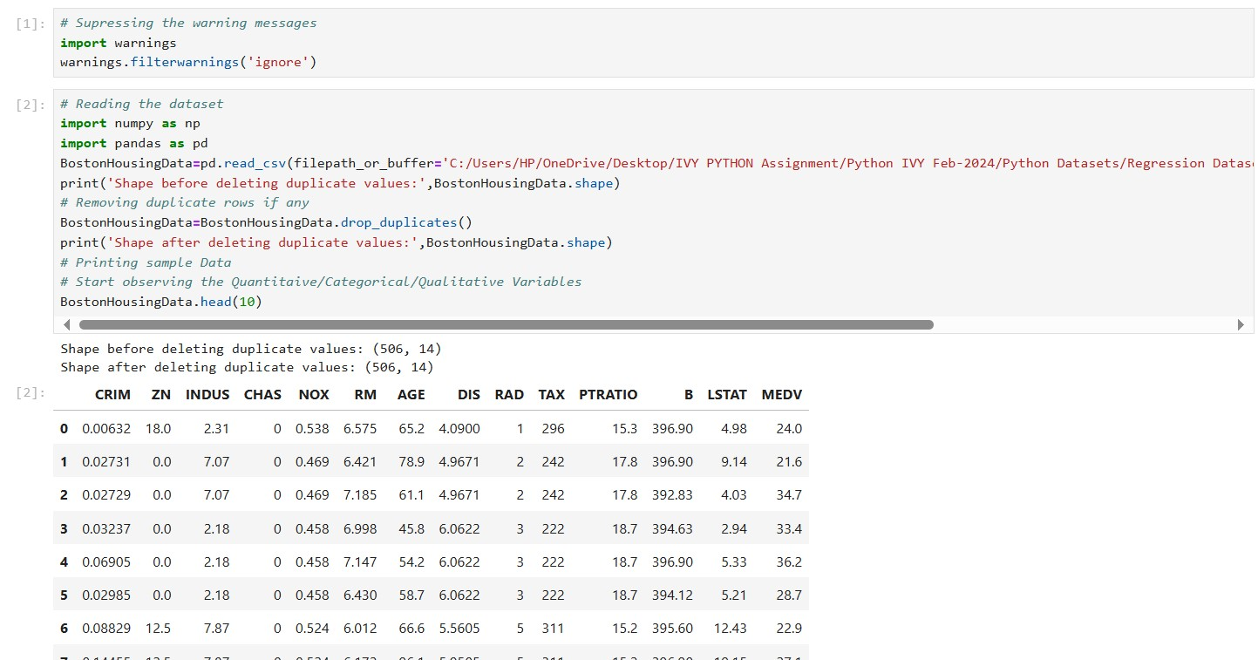
Data Loading And Initial Cleaning
The code suppresses warning messages and reads the Boston housing dataset while checking for duplicate rows, ensuring data integrity before analysis. It then displays the shape of the dataset before and after removing duplicates and prints the first ten rows to begin examining the variables.

Slide 5
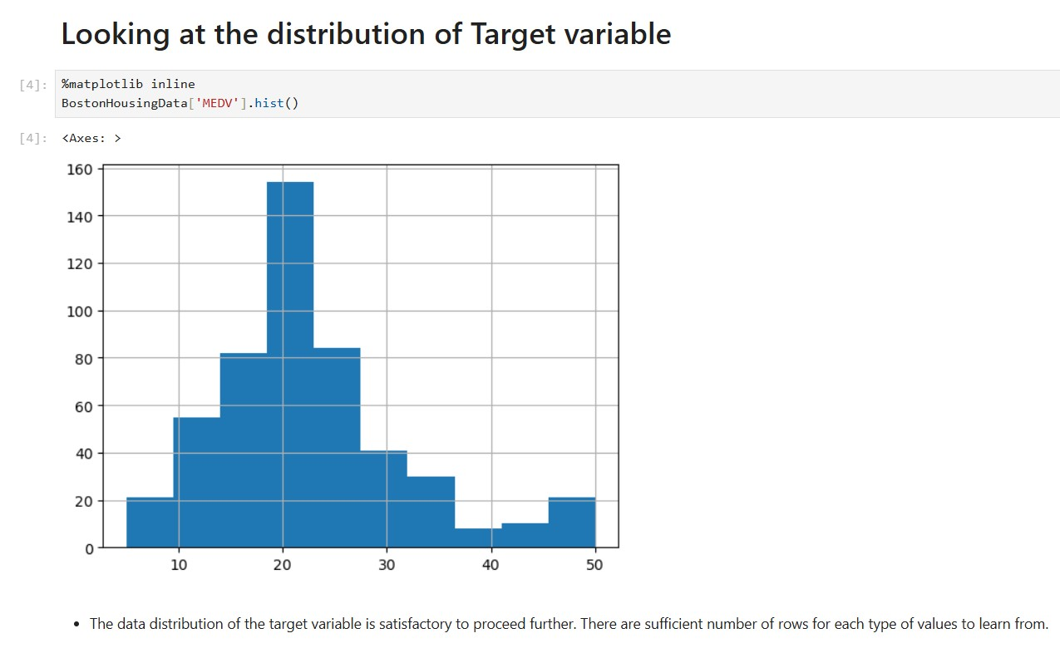
Analysis Of The Target Variable Distribution
The histogram of the target variable, MEDV, shows a satisfactory distribution, indicating sufficient data points across different value ranges for effective learning. This suggests that we can proceed with the analysis and modeling confidently.

Slide 6
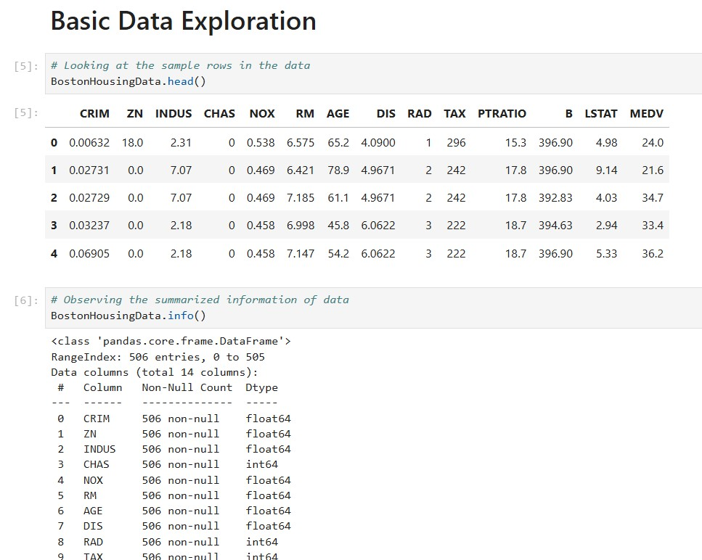
Foundations Of Data Exploration And Overview Of Dataset Structure
The code displays the first few rows of the Boston housing dataset to provide a glimpse of the data structure and values. Additionally, it summarizes the dataset's information, revealing data types and the presence of any missing values, which is crucial for understanding the dataset's readiness for analysis.

Slide 7
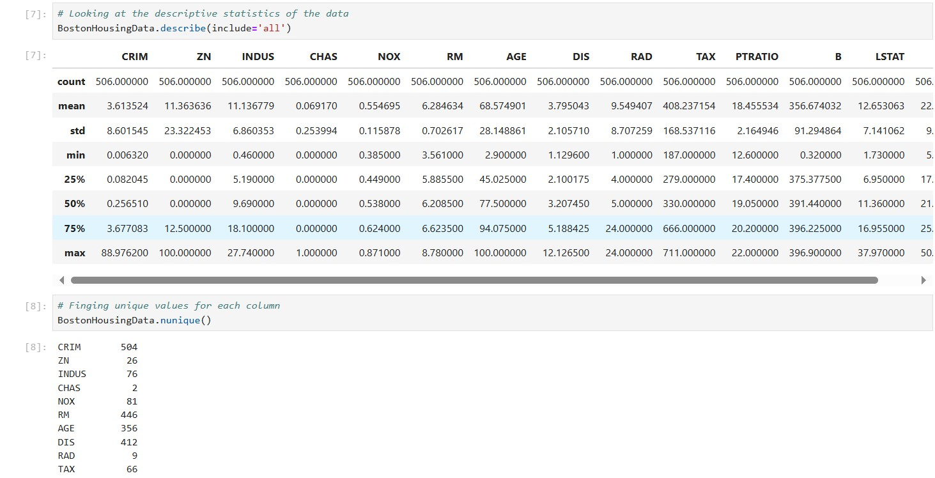
Descriptive Statistics Summary And Unique Value Analysis
The code generates descriptive statistics for the Boston housing dataset, offering insights into the central tendency, spread, and distribution of features. It also identifies the unique values in each column, helping to assess data variability and inform further analysis.

Slide 8
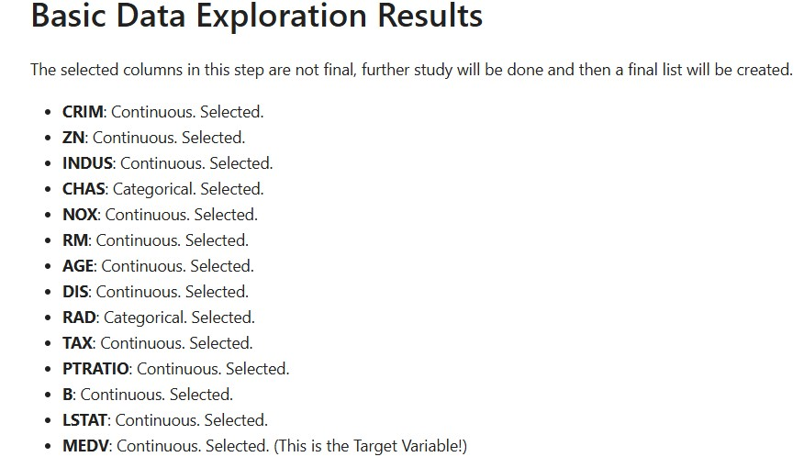
Initial Feature Selection and Roadmap
The data exploration confirmed that all selected columns are either continuous or categorical, with no qualitative variables present. Therefore, no columns were removed, and the current features will be refined in the next steps for model development.

Slide 9
Visualizing Categorical Variables In The Dataset
A custom function is created to generate bar charts for visualizing the distribution of the categorical predictors, 'CHAS' and 'RAD'. These bar plots help to observe how frequently each category occurs, providing insights into the data's structure for these variables.

Slide 10
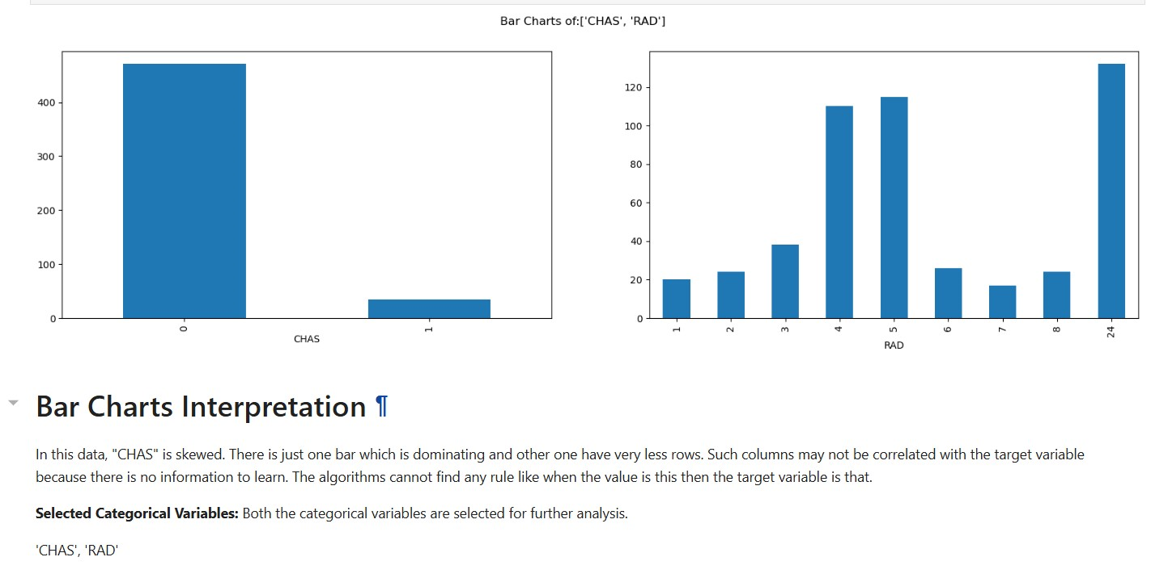
Bar Charts Interpretation
The bar chart shows that 'CHAS' is highly skewed, with one category dominating, making it less likely to contribute to meaningful predictions. However, both 'CHAS' and 'RAD' are still selected for further analysis to assess their potential impact on the model.

Slide 11
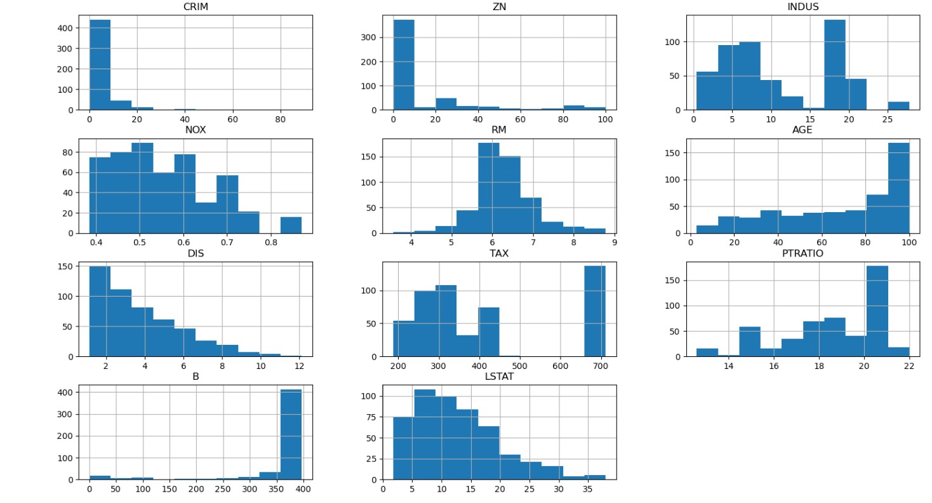
Histogram Interpretation
The histograms show that all continuous variables have acceptable distributions, with only 'CRIM' displaying outliers that require treatment. All continuous predictors, including 'ZN,' 'RM,' and 'LSTAT,' are selected for further analysis.

Slide 12
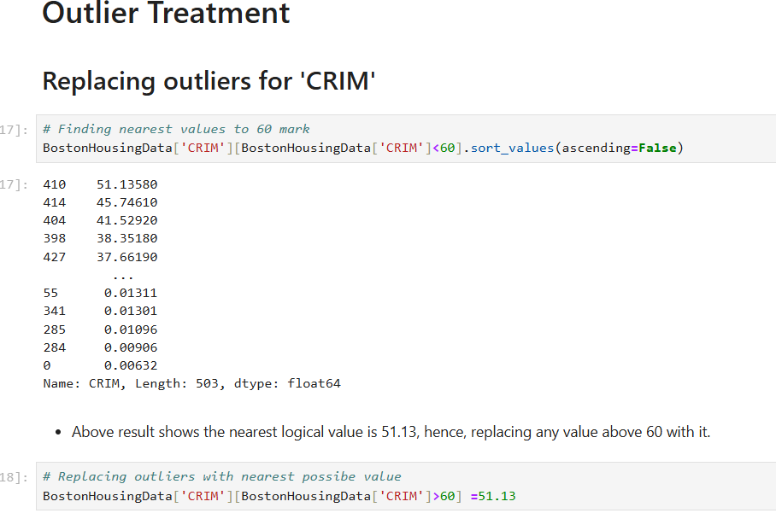
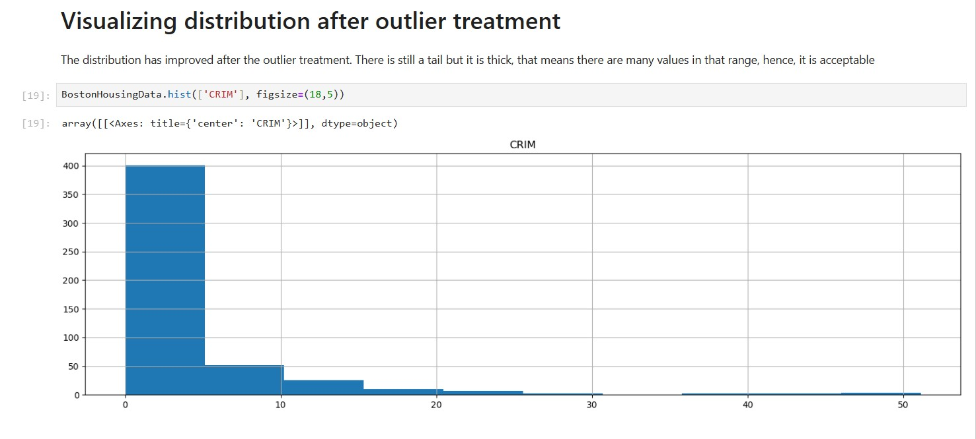
Outlier Detection and Treatment
Outliers in the 'CRIM' variable, values above 60, were replaced with 51.13 to improve the distribution. After treatment, the distribution is more balanced, with a thicker tail indicating a reasonable range of values, making it acceptable for further analysis.

Slide 13
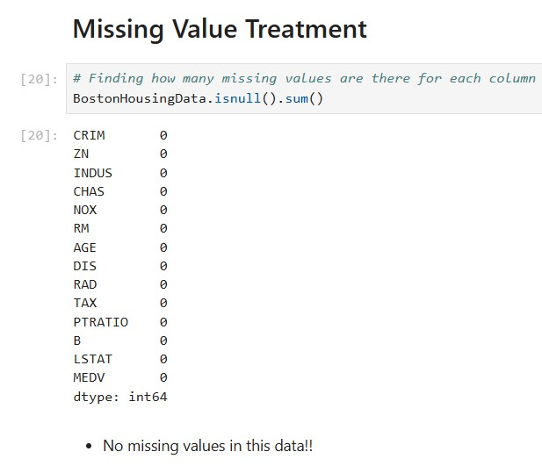
Missing Values Treatment and Imputation
The code checks for missing values in each column of the dataset, confirming if any data is incomplete. This step ensures data quality before proceeding with further analysis and modeling.

Slide 14
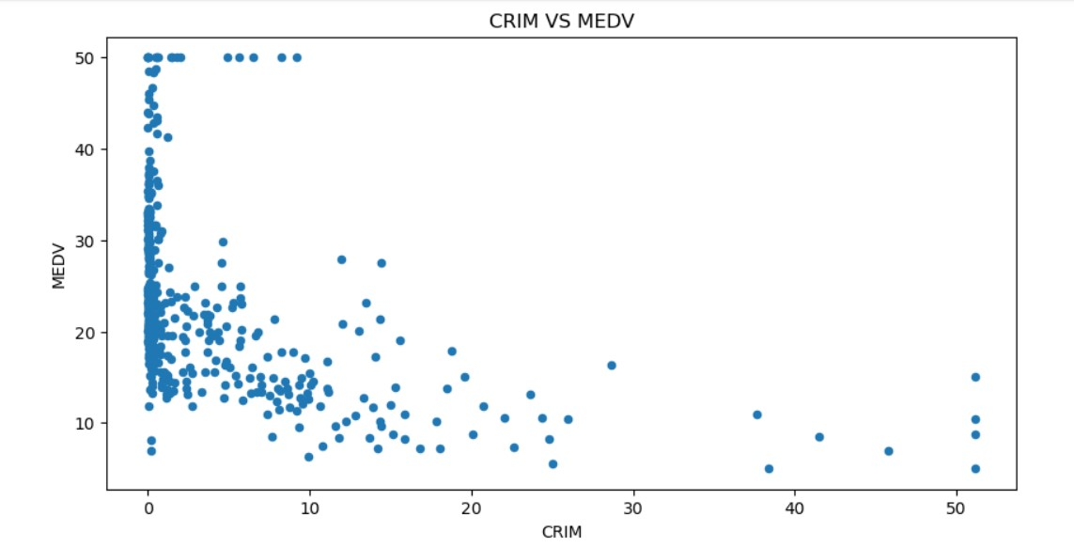
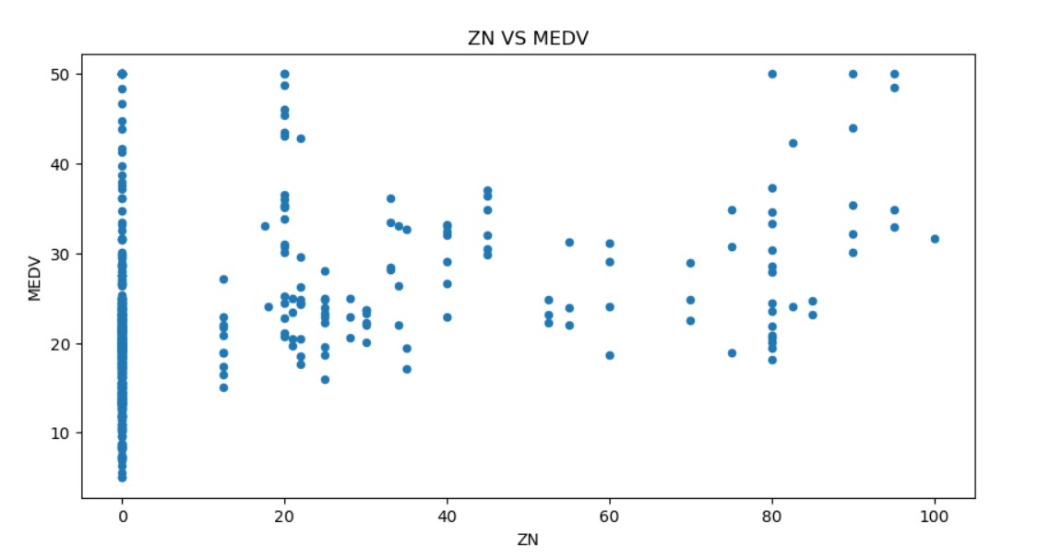
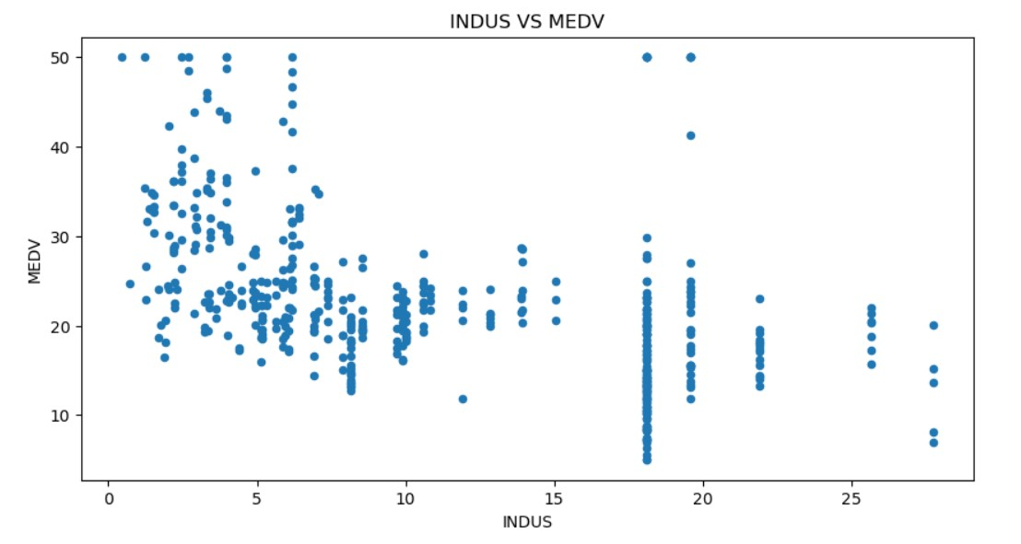
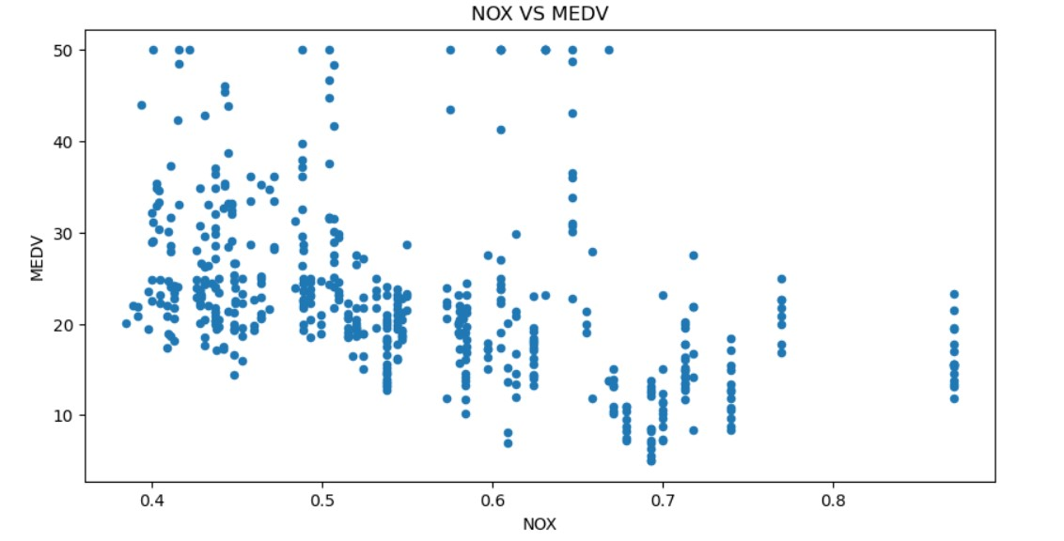
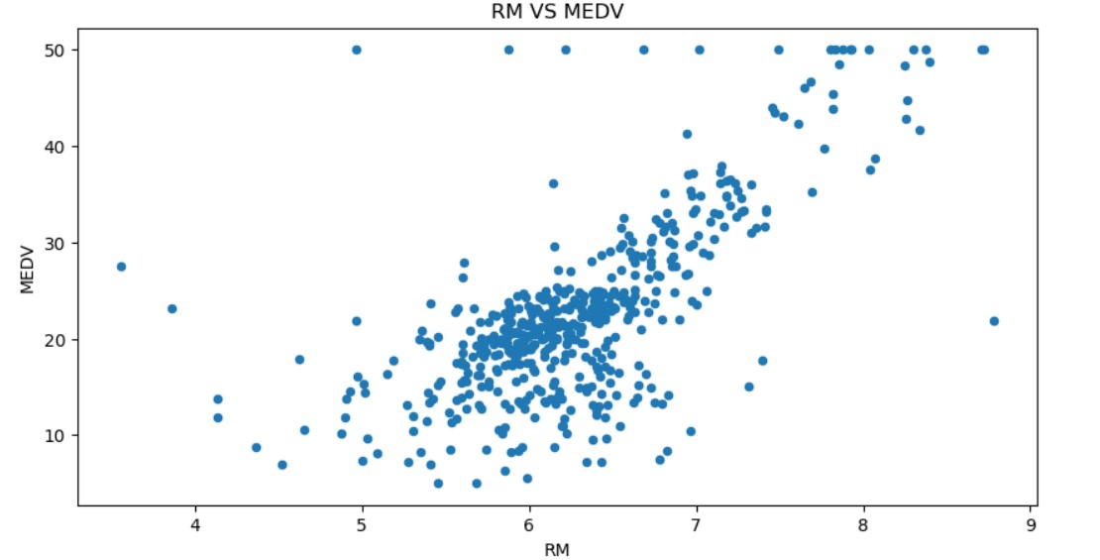
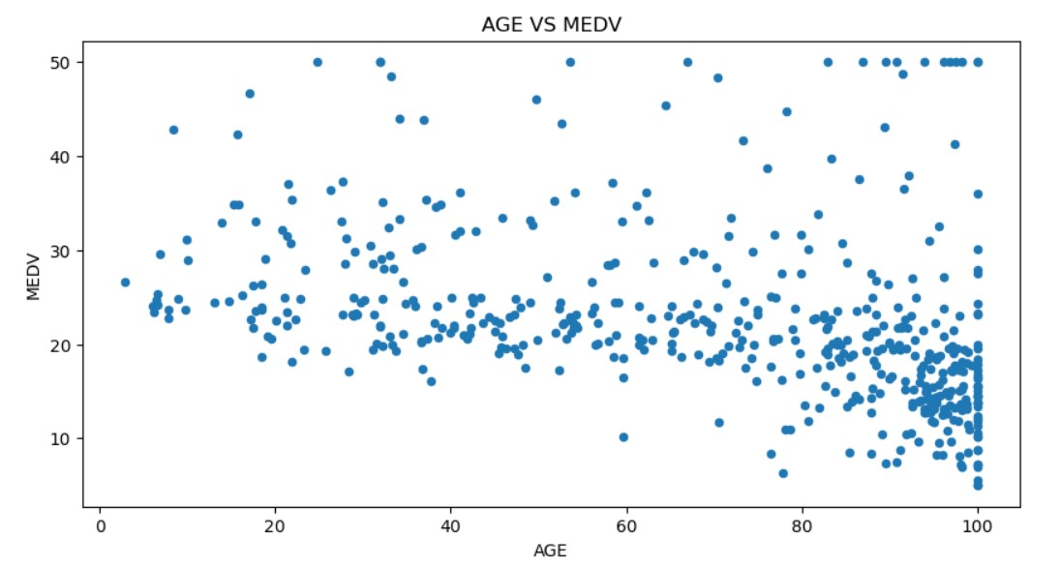
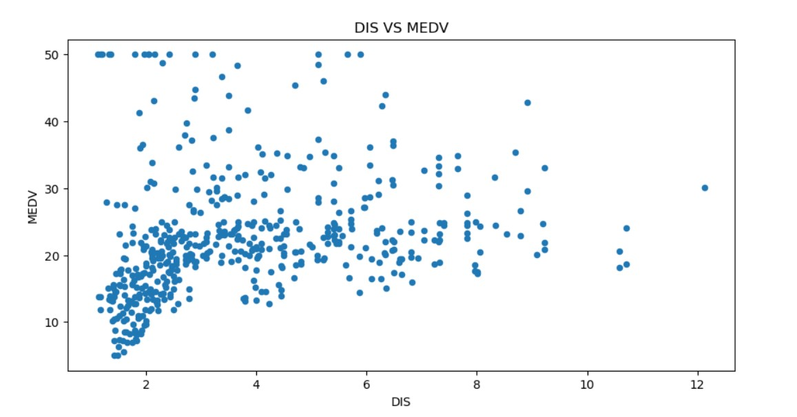
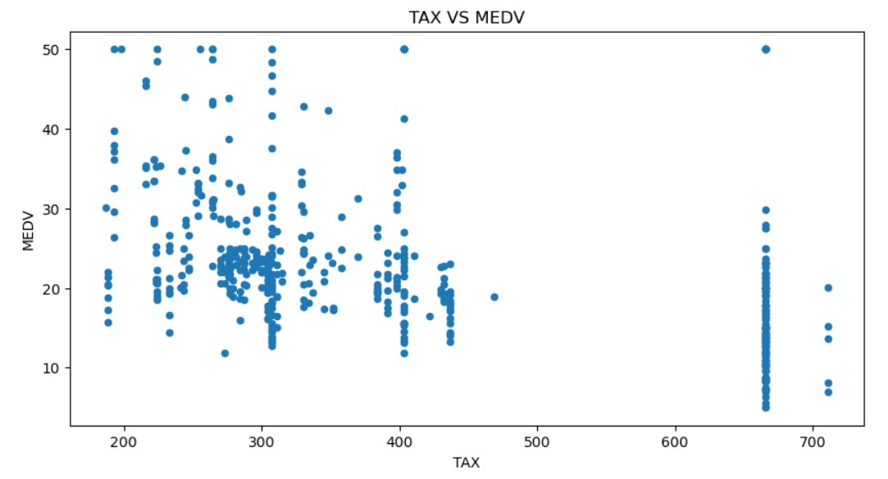
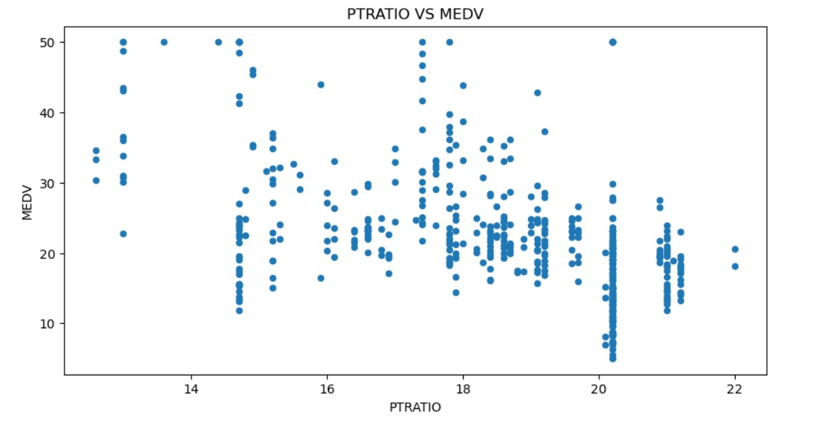
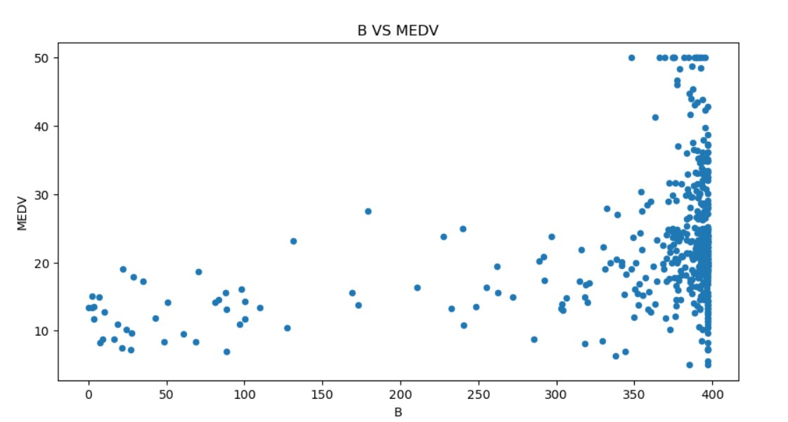
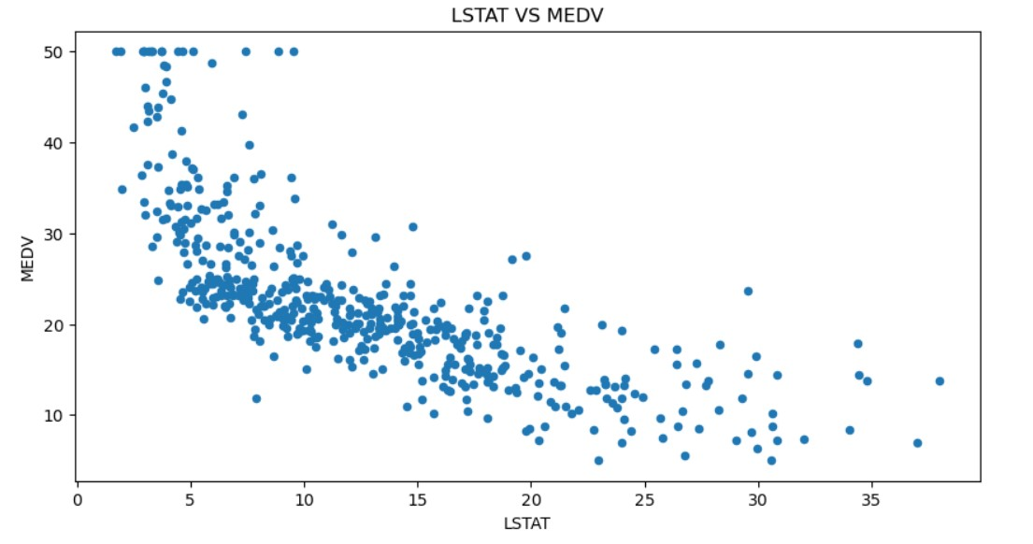
Scatter Chart Interpretation and Correlation Analysis
The scatter charts provide insights into the relationship between each continuous predictor and the target variable, helping to assess their usefulness for modeling. Correlation values further validate these observations, indicating the strength and direction of the relationships.

Slide 15
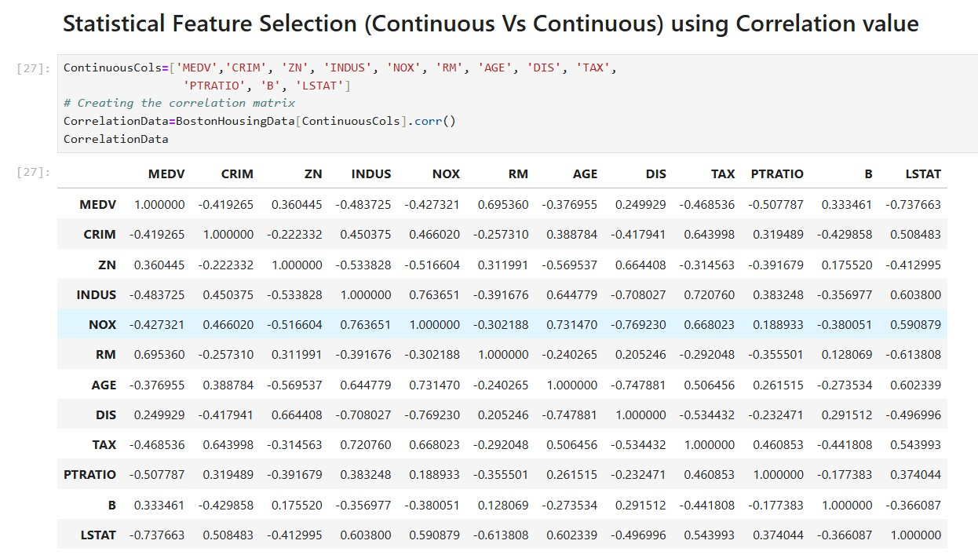
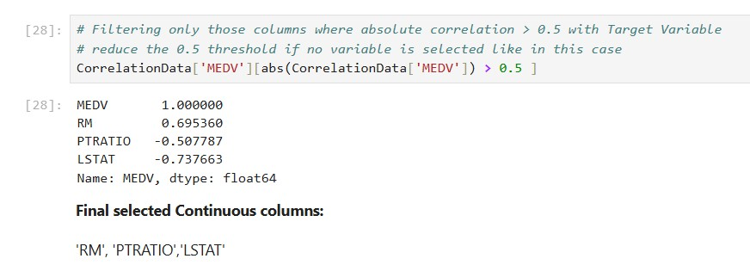
Statistical Feature Selection: Correlation Analysis
The correlation matrix is created to assess the relationships among continuous variables, including the target variable, MEDV. By filtering for absolute correlation values greater than 0.5, we identify significant predictors that have a strong relationship with the target variable, guiding feature selection for the model.

Slide 16
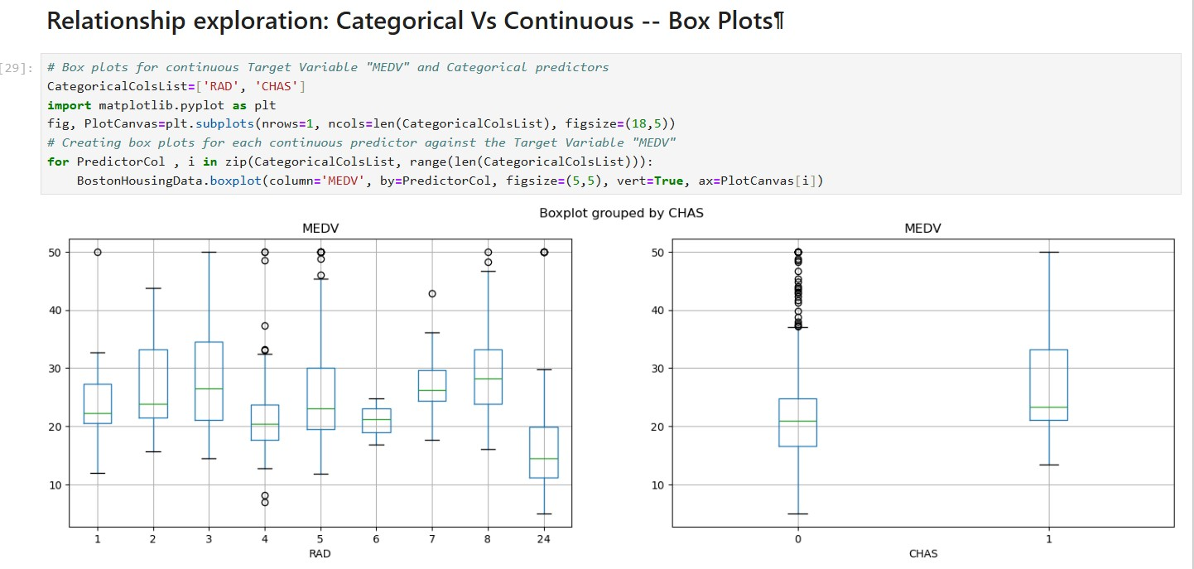
Box Plot Interpretation and ANOVA Analysis
The box plots illustrate the distribution of MEDV across different categories of 'RAD' and 'CHAS,' highlighting variations in median values. The results of the ANOVA test will further validate whether these differences are statistically significant, confirming the predictors' relevance to the target variable.

Slide 17
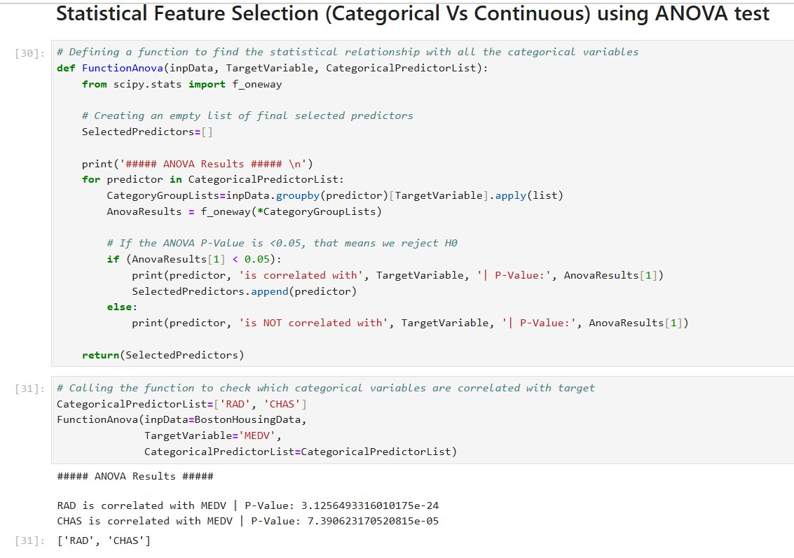
Statistical Feature Selection: ANOVA Test for Categorical Variables
The ANOVA test is performed to assess the relationship between the categorical predictors 'RAD' and 'CHAS' with the continuous target variable MEDV. Both predictors are found to be statistically significant, with p-values less than 0.05, confirming their relevance for further analysis.

Slide 18
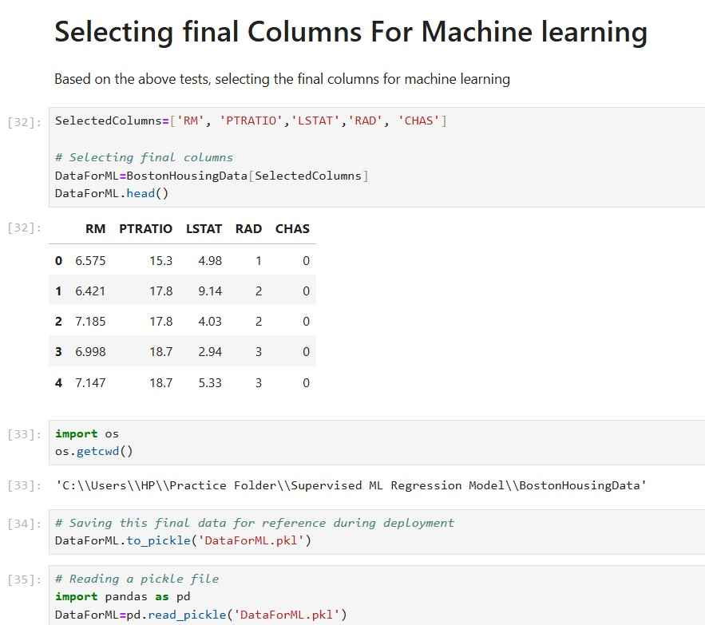
Final Feature Selection for Machine Learning
Based on the feature selection process, the final columns chosen for machine learning are 'RM', 'PTRATIO', 'LSTAT', 'RAD', and 'CHAS.' These columns are extracted from the dataset to proceed with model building.

Slide 19
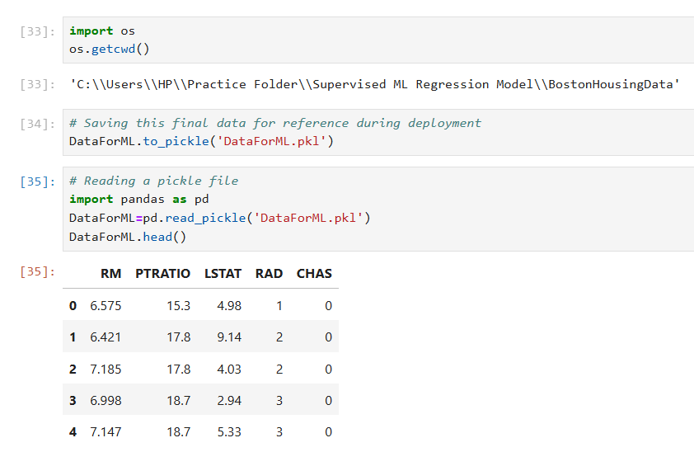
Saving and Loading Final Dataset for Deployment
The final dataset is saved as a pickle file ('DataForML.pkl') for future reference during deployment. The dataset contains the selected features for machine learning, which can be easily loaded and used for model training.

Slide 20
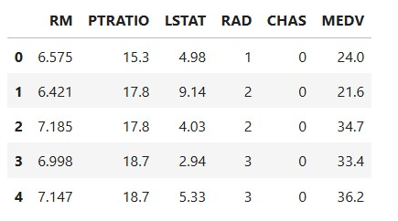
Encoding Categorical Variables and Preparing Final Dataset
Dummy variables were created for the nominal features to convert categorical data into a numeric format. The target variable, 'MEDV,' was then added to the transformed dataset for further analysis and model building.

Slide 21
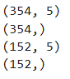
Splitting Data for Model Training and Testing
The dataset is divided into training (70%) and testing (30%) sets to create a robust model and evaluate its performance on unseen data. The training set is used to build the model, while the testing set is reserved for validation. This split helps assess the model’s accuracy and generalization to new data.

Slide 22
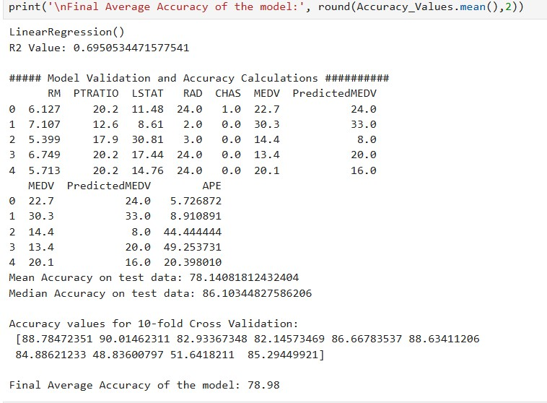
Multiple Linear Regression Model Evaluation
The multiple linear regression model demonstrated an R² value of 0.69 on the training data, indicating a reasonable fit for the data. After evaluating the model's predictions on the test data, it achieved a mean accuracy of 78.14%. Additionally, the 10-fold cross-validation revealed an average accuracy of 78.98%, suggesting consistent performance across different subsets of the data.

Slide 23
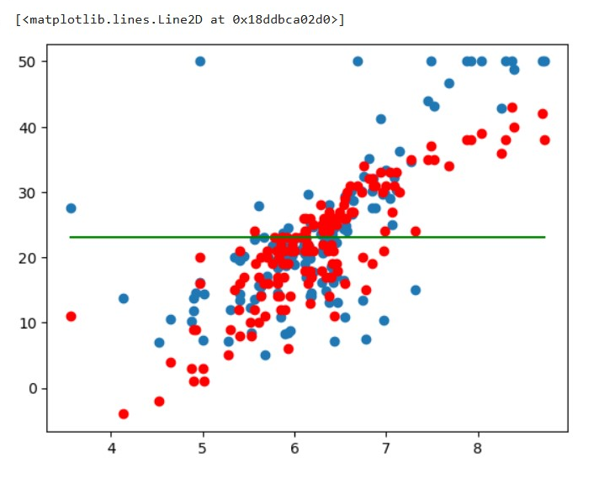
Visualizing the Regression Results
The code visualizes the line of best fit for the median home values (MEDV) against the number of rooms (RM), showing actual values as blue dots, predicted values as red dots, and the average median value as a green line. It also retrieves the coefficients for each predictor variable, indicating the relationship strength, and the intercept for the regression model.

Slide 24
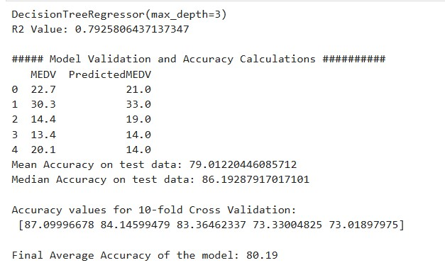
Decision Trees for Regression Analysis
This section implements a Decision Tree Regressor to predict the target variable, evaluating its performance through R² scores and accuracy calculations, while visualizing feature importance. The model's accuracy is further validated using 10-fold cross-validation to ensure robustness in predictions.

Slide 25
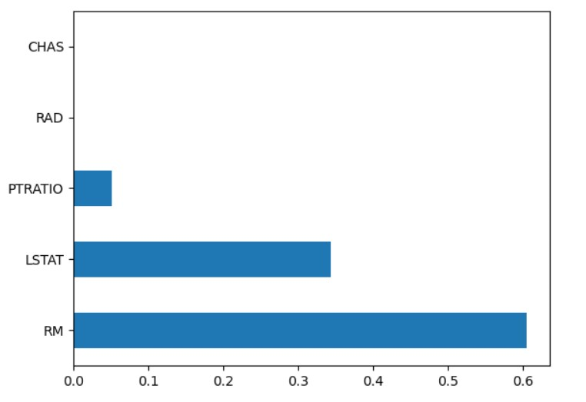
Decision Tree Model Performance Summary
The Decision Tree Regressor achieved an R² value of approximately 0.79, indicating a strong fit, with a mean accuracy of around 79.01% on the test data and an average accuracy of 80.19% from 10-fold cross-validation, demonstrating its predictive reliability.

Slide 26
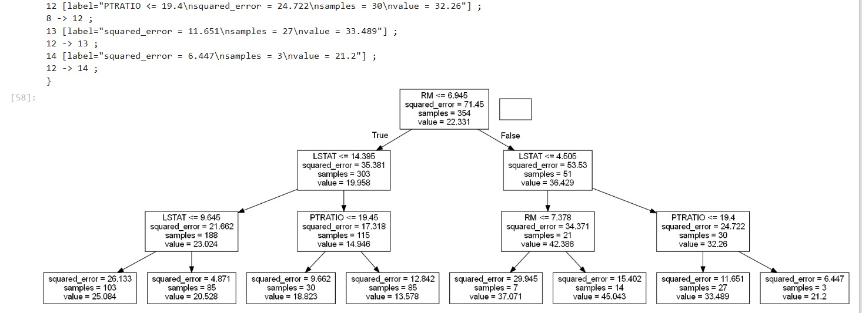
Visualizing the Decision Tree
The Decision Tree is visualized using Graphviz, where the DOT data is generated and converted into a graphical representation, illustrating the feature splits and decision rules for the trained model. This visualization aids in understanding the model's structure and decision-making process based on the input features.

Slide 27
THANK YOU

